Slide 1

Start Threat Modeling II: 28 Weeks Later
Adam Twitty

Slide 2
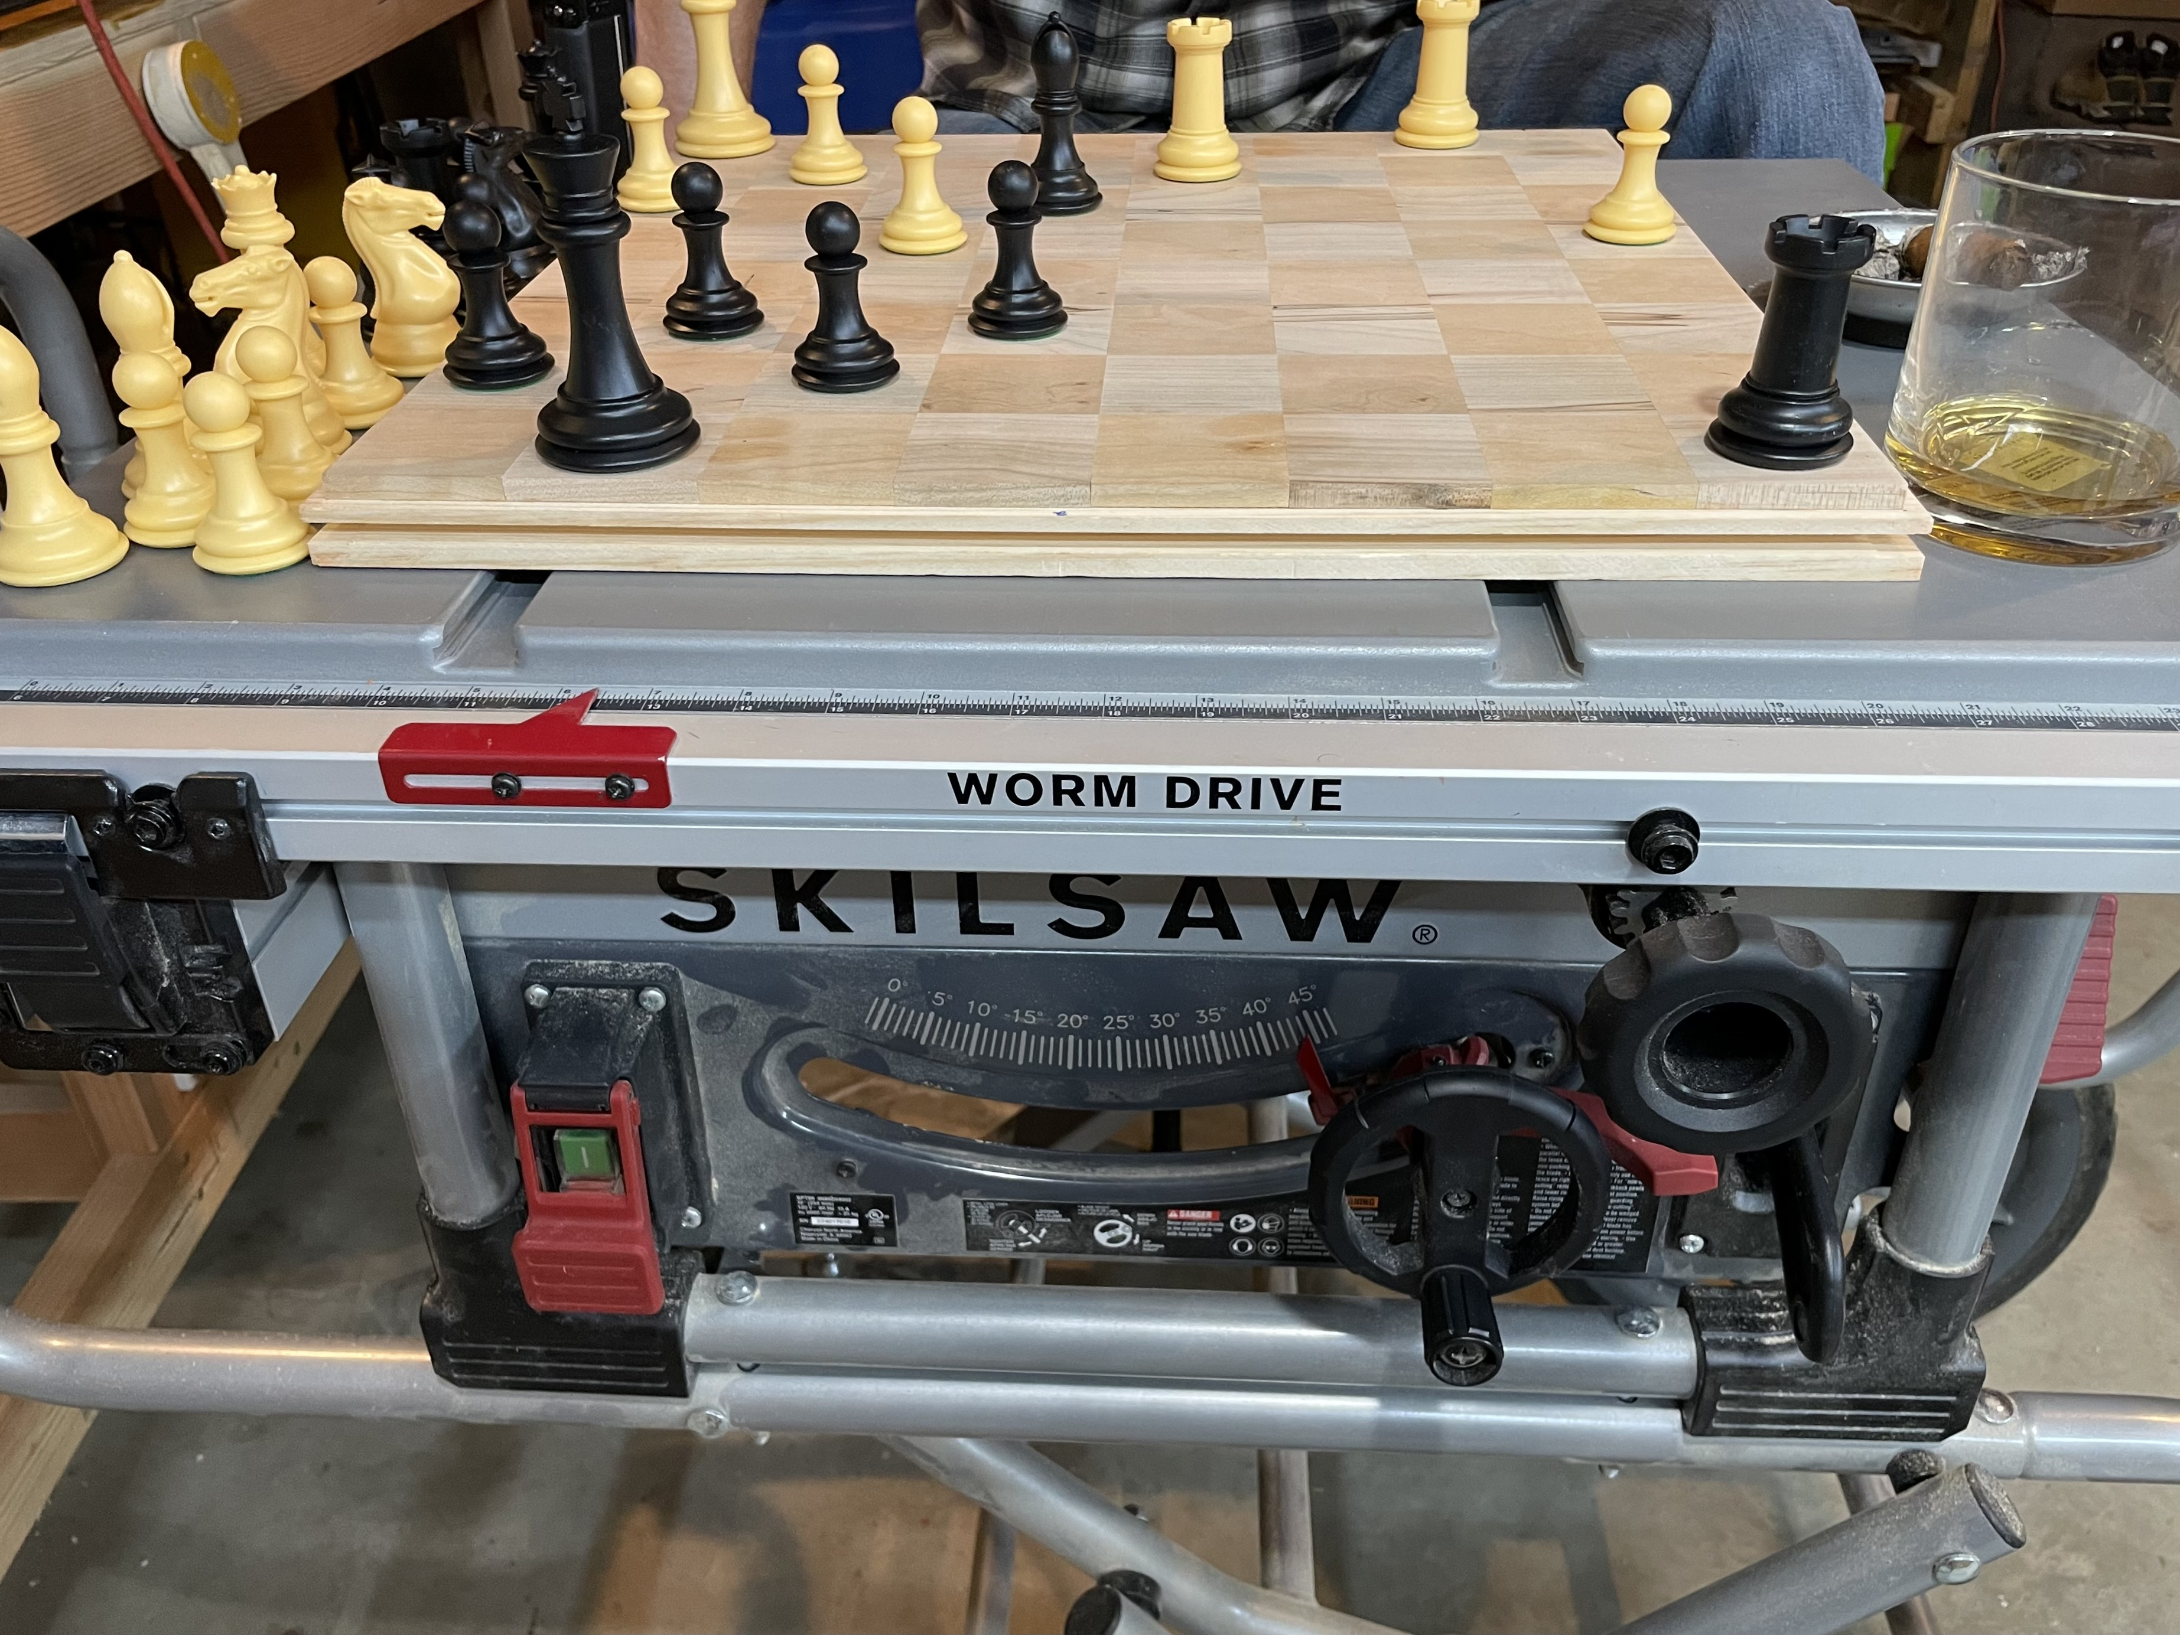
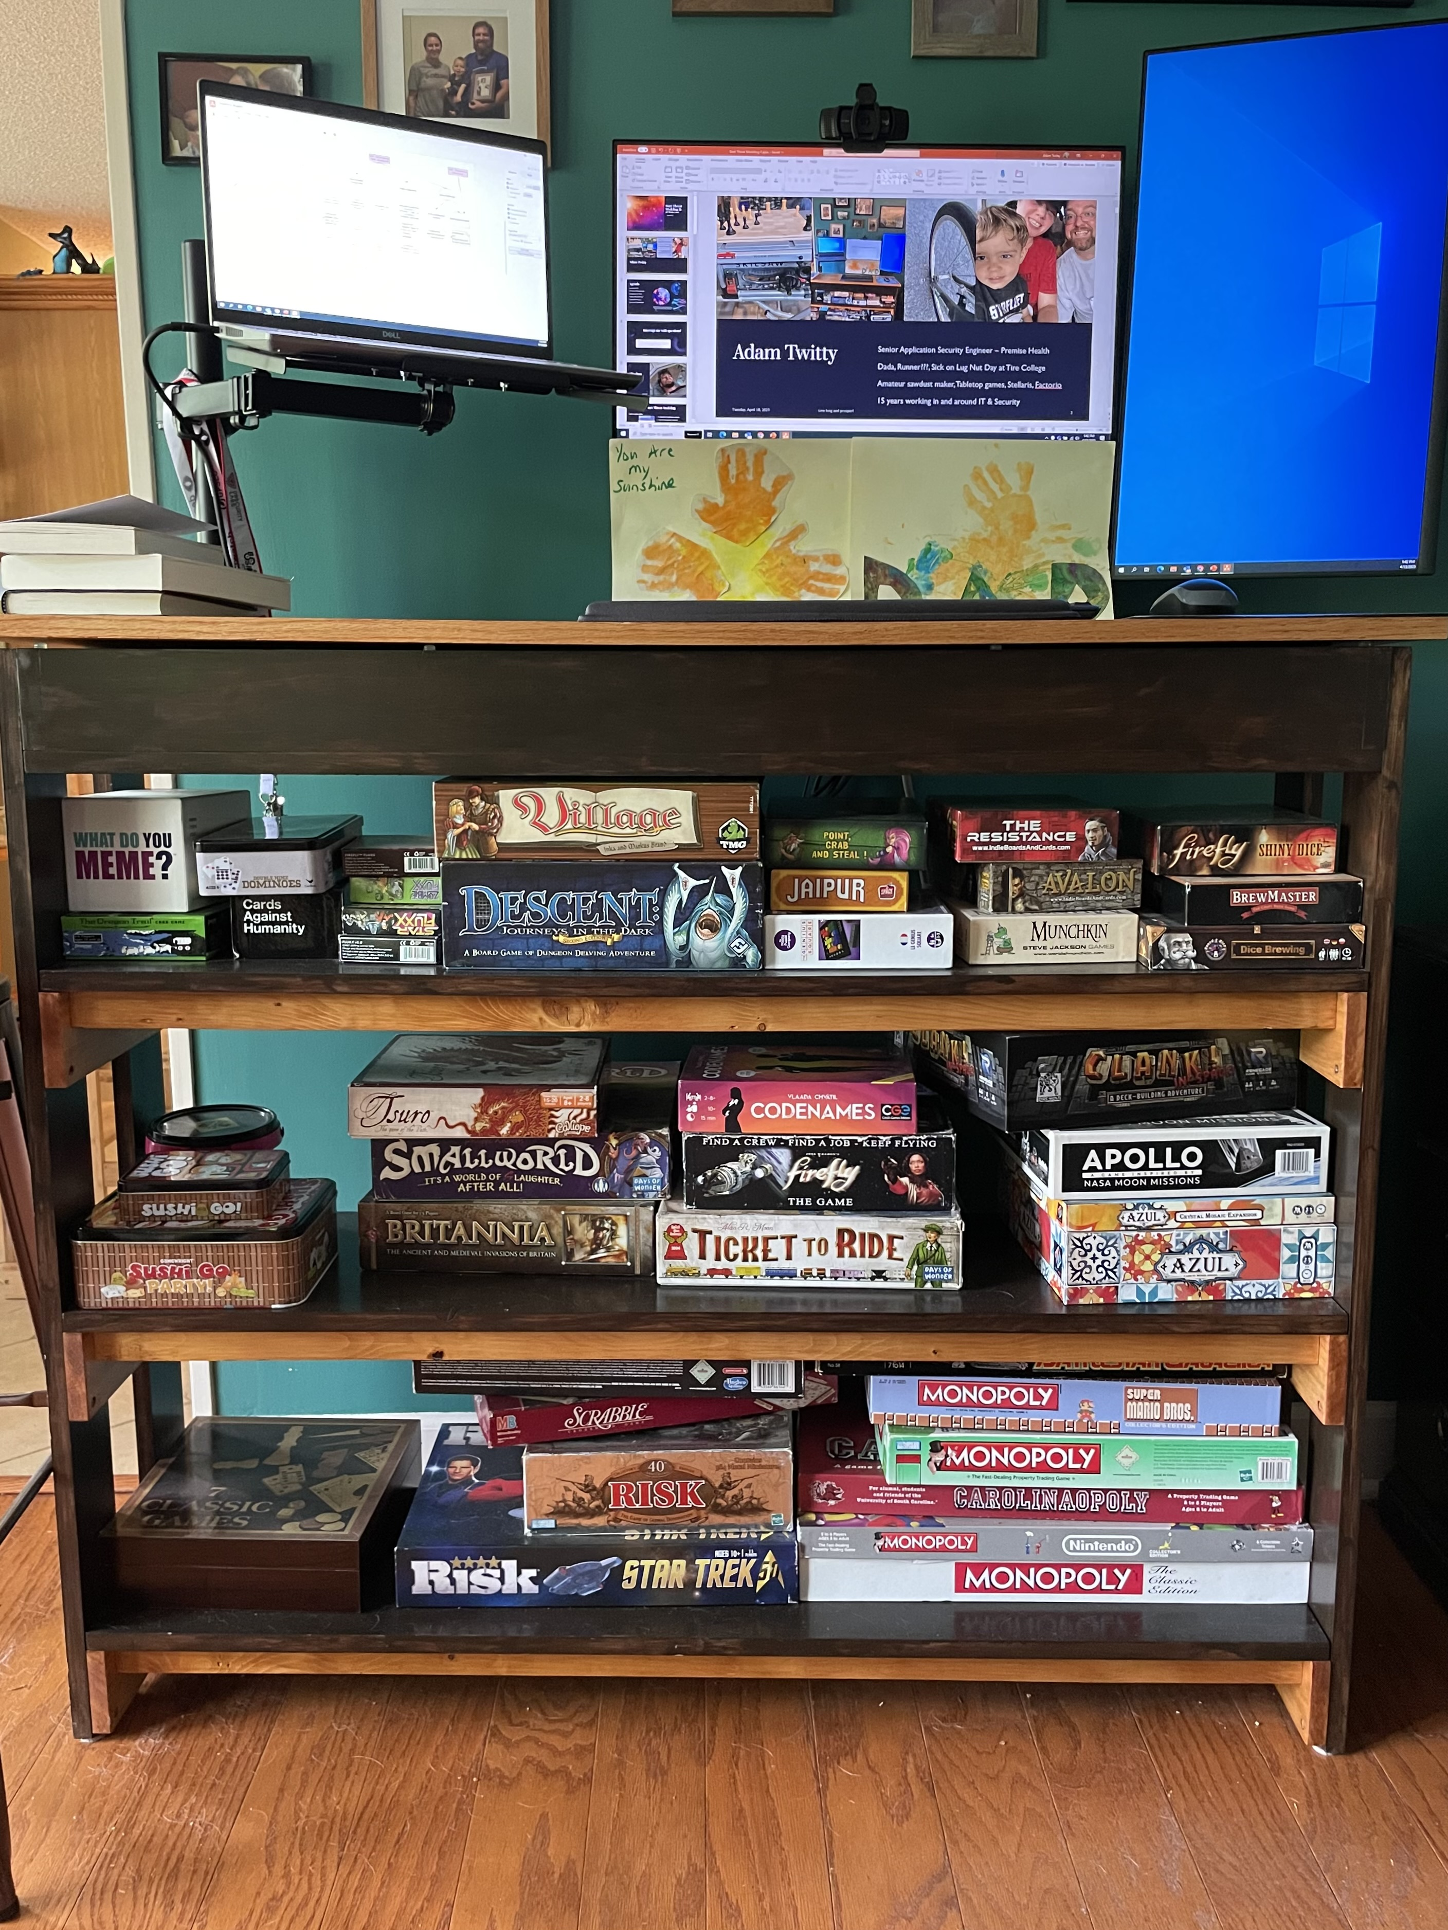


Adam Twitty
Senior Application Security Engineer – Premise Health
Dada, Runner???, Sick on Lug Nut Day at Tire College
Amateur sawdust maker, Tabletop games, Stellaris, Factorio
15 years working in and around IT & Security

Slide 3



Agenda
Last time on STM
Refinement & Tooling Update
Components of a Model
Building a Complete Model
Home Grown Produce
Resources & Methodologies
WARNING: This is a mess of references & the original theme has been totally abandoned

Slide 4
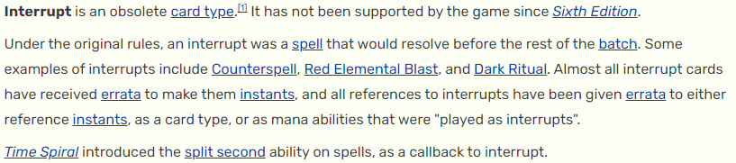
Interrupt me with questions!

Slide 5

Clip show time!

Slide 6
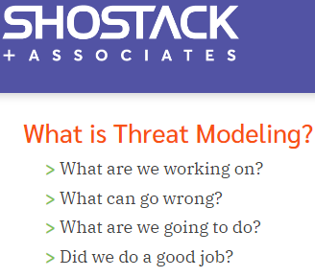

Last time on Start Threat Modeling
What is a threat model?
A collection of artifacts in a library.
Actor & Component Inventory
Diagrams
Bug/Issue/Threat List
Contact List

Slide 7
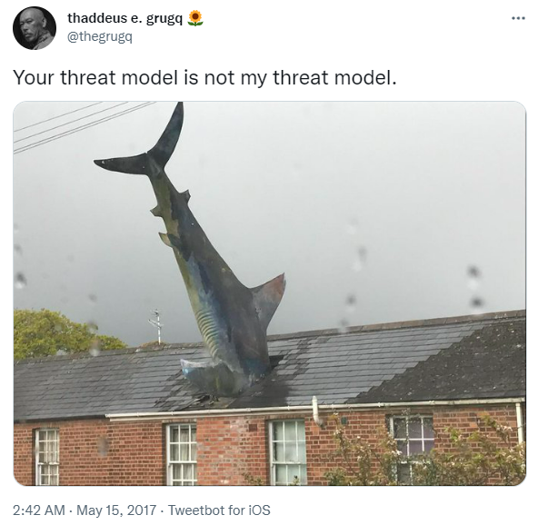
Last time on Start Threat Modeling
Why create a threat model?
Socialize (and document!) system design
Identify weaknesses
Consider threats from multiple viewpoints
Threats to be considered are heavily influenced by industry vertical, posture of the organization, market share, and customers
Attacker cost should factor into your security posture
Writing things down helps us understand them better.

Slide 8

Last time on Start Threat Modeling
Who do we need?
Developers
Infrastructure support
Database admins
Compliance
Business Analysts

Slide 9
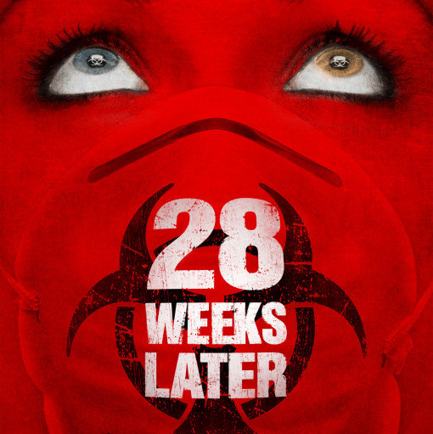
What have we learned?

Slide 10
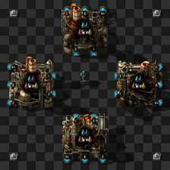
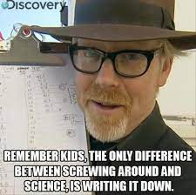
Refinement
What is a threat model?
Identify:
assets to be protected
potential threats
vulnerable configurations & processes
Analyze impacts & risks of identified threats
Develop mitigation strategies
Inform testing
Document accepted risks

Slide 11

Refinement
Tools
What I’m using
White Board
Visio
Draw.IO
OWASP Threat Dragon
Microsoft Threat Modeling Tool
Something to track bugs with
Draw.io
Dataflow Diagrams
Attack Trees
Confluence
Narrative components
Excel
Issue tracking

Slide 12
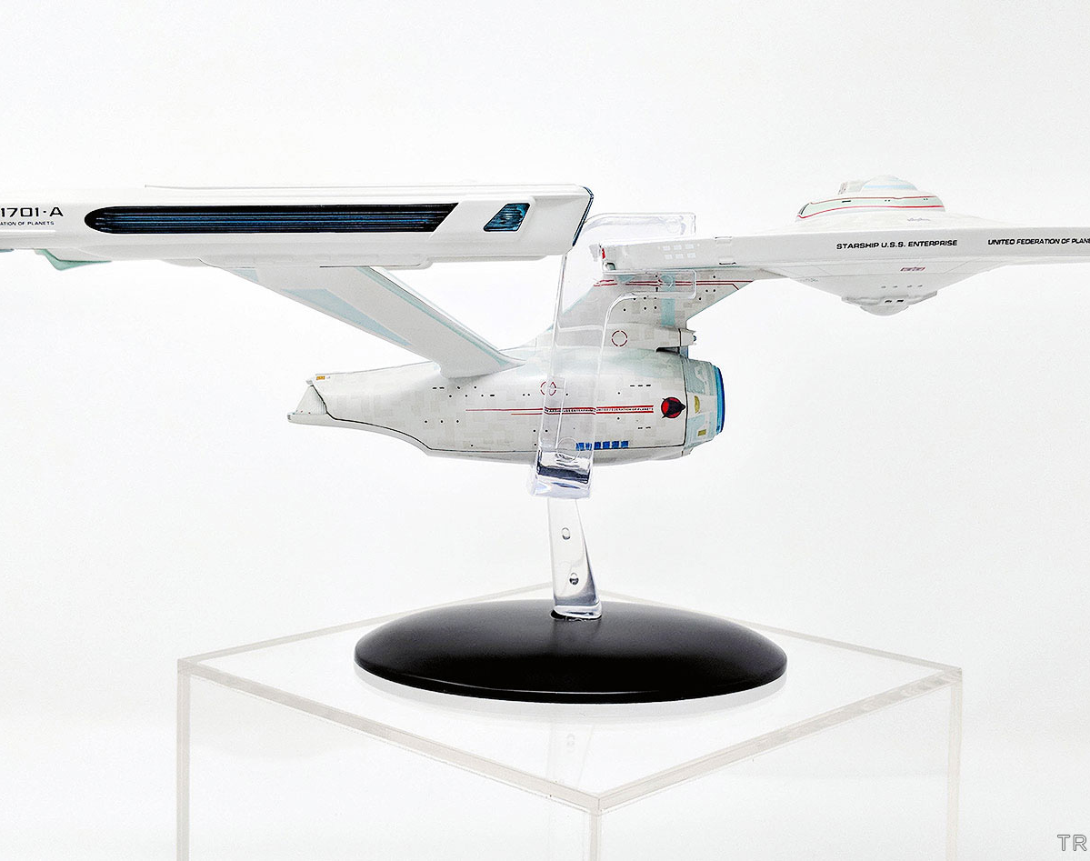
Playing with models

Slide 13
A Complete-ish Threat Modeling Overview
Narrative
Visual Models
Work lists
Scope
URLs, repos
Component list (include 3rd party services)
Details on the system & how it’s built.
Who’s contributed
Data Flow Diagrams
Process flow, but only as needed
Attack Trees
Spreadsheets or work tickets to enumerate all risks & threats, tracked to resolution.
A year from now you won’t remember what threats & mitigations you considered.

Slide 14
Narratives
Topics to cover
Enumerate components
Include 3rd parties
Authentication
Logging
Alerting
Users
How are permissions structured
How many types of users are there?
Features – enumerate each
Describe what it does
What data is consumed
What data is produced
Which components does the data flow through

Slide 15

Michael Henricksen
https://github.com/michenriksen/drawio-threatmodeling

Slide 16
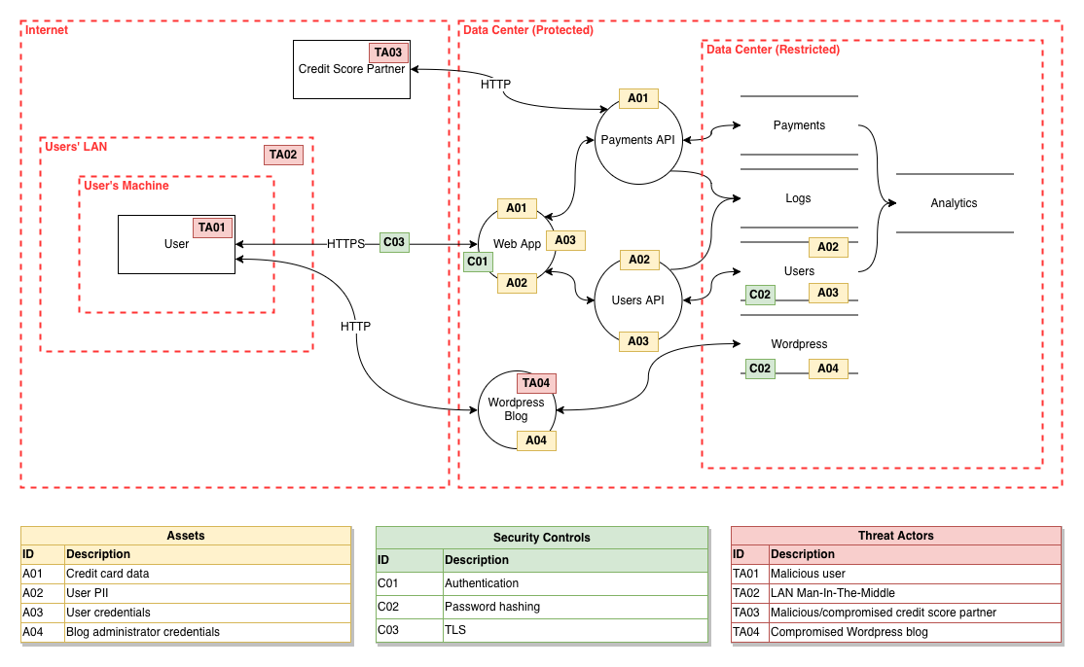

Slide 17
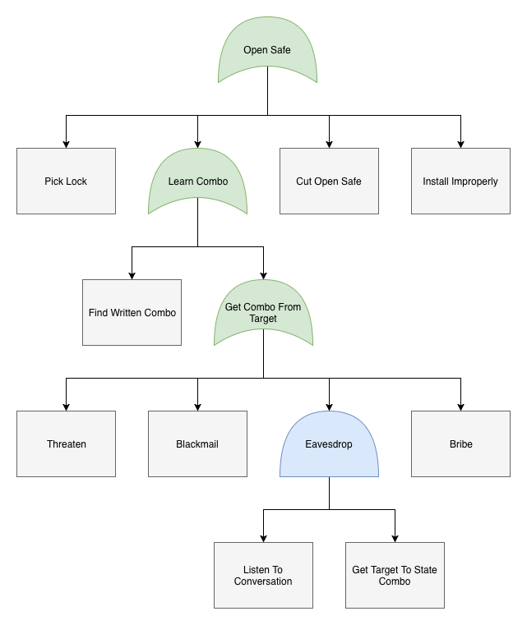
Attack Trees
Identify:
Attacker
Objectives
Methods
Costs
Existing mitigations & controls
Gaps

Slide 18

Building a Threat Model
Subtitle

Slide 19
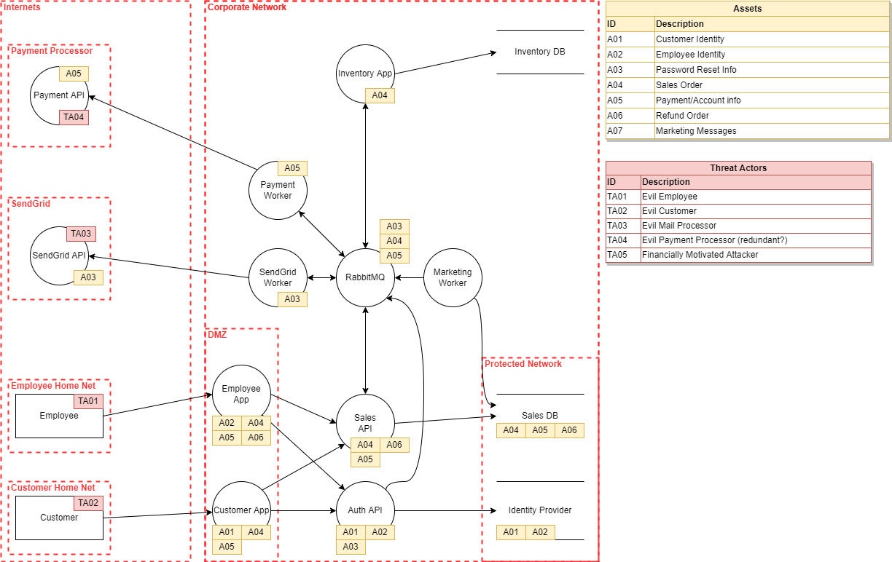
Starting with a good Model
App contains:
2 front ends
2 APIs
a messaging queue
3 worker jobs/programs
2 databases
Interacts with
Payment API
Mail Provider API
Hypothetical company/app
Sales employees
Customers
Interacts with inventory app, out of scope

Slide 20
Data flow in DrawIO

Slide 21
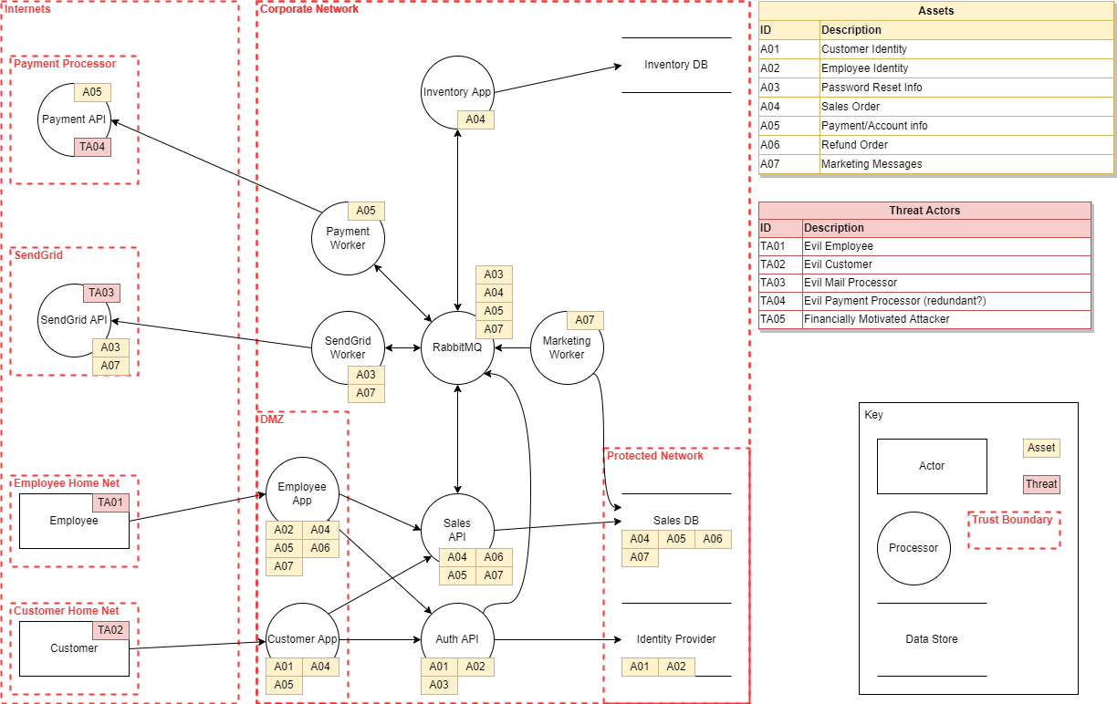

Slide 22
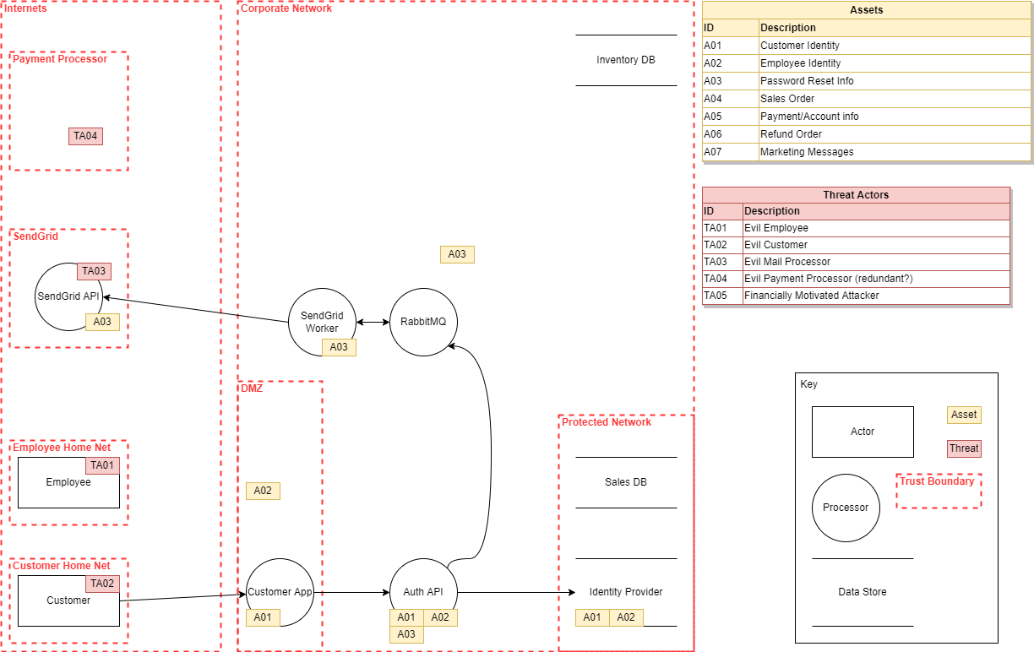
Identity & Password resets

Slide 23
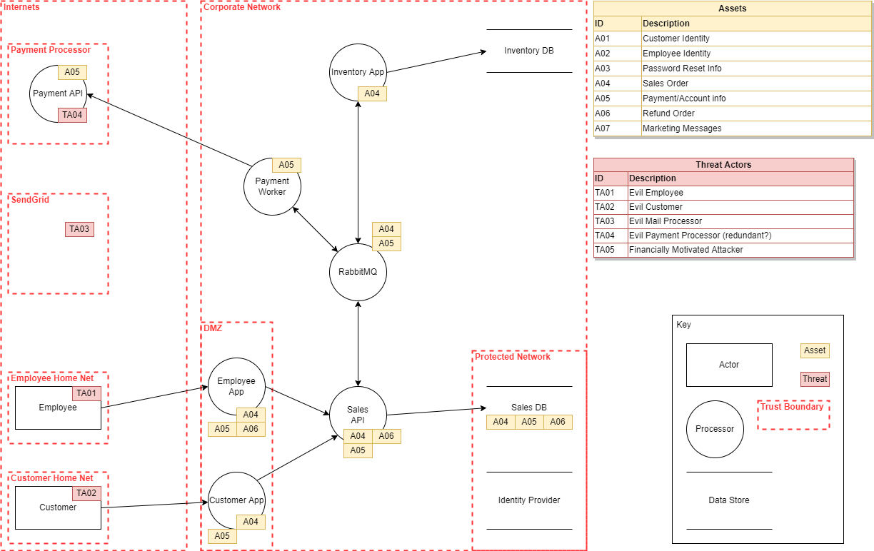
Sales, Payment, and Refunds

Slide 24
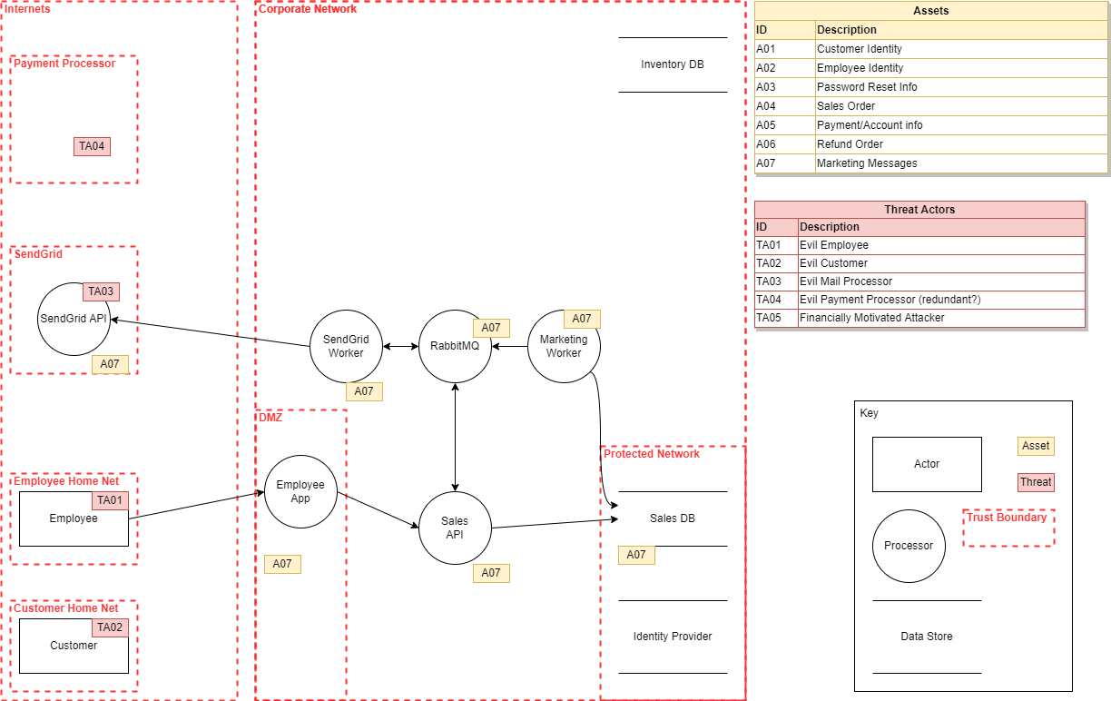
Marketing Data

Slide 26
How do we build the attack tree?

Slide 27
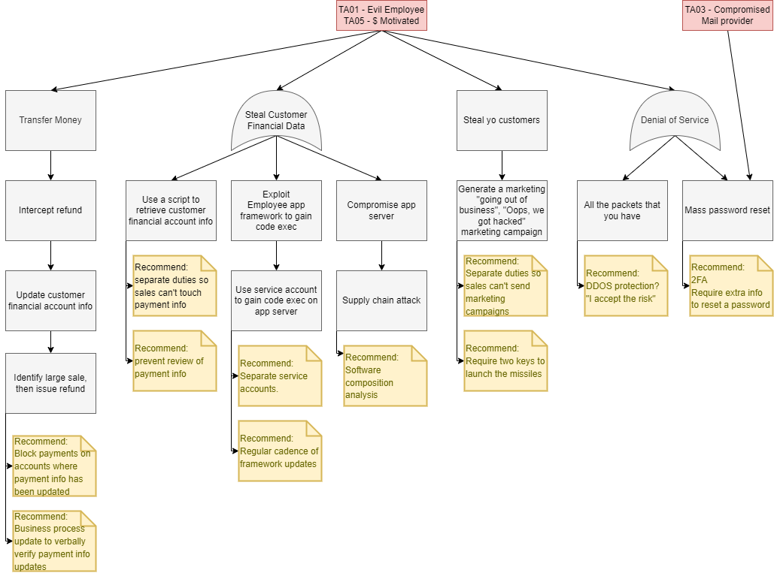

Slide 28
Demo Time!

Slide 29
Home Grown Produce
So what now?
Capture Work Items
Iterate & Maintain
Narrative & Data Flow issues
Attack tree analysis
Review work items with development and support team
Don’t delete, mark as resolved
Socialize it, your objective is to farm ideas and “what about”s from your team
Iterate via periodic review
Periodically summarize issues identified & resolved – Show value from the process!

Slide 30
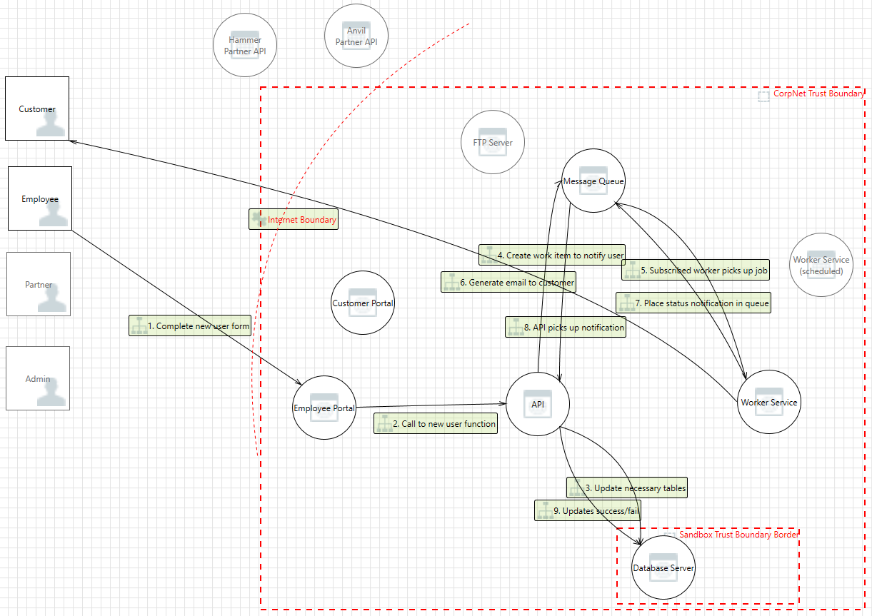
What about Process Flow Diagrams?
Objective is to exhaustively capture each step in a particular business process within an application.
Uncovers interactions & systems which were overlooked.
Powerful, but too time intensive for regular use.
Tedious for all involved.

Slide 31
Resources
Tools
Links
Methodologies
DrawIO
White Board
Excel || Bug Tracker || KanBan
OWASP Threat Dragon
Microsoft Threat Modeling Tool
https://github.com/michenriksen/drawio-threatmodeling
https://github.com/ndecizion/ThreatModelingPlaybook
https://shostack.org/
If you find yourself stuck in analysis & brainstorming attacks, fall back on these
STRIDE
DREAD
PASTA
VAST

Slide 32


Thank You
Adam Twitty
Adam.twitty@premisehealth.com
https://github.com/ndecizion/ThreatModelingPlaybook

